Slide 1

Yale
Workshop on evaluating vaccine impact
Use of controls to improve estimates of vaccine impact
Dan Weinberger, PhD
Associate Professor
Yale School of Public Health

Slide 2
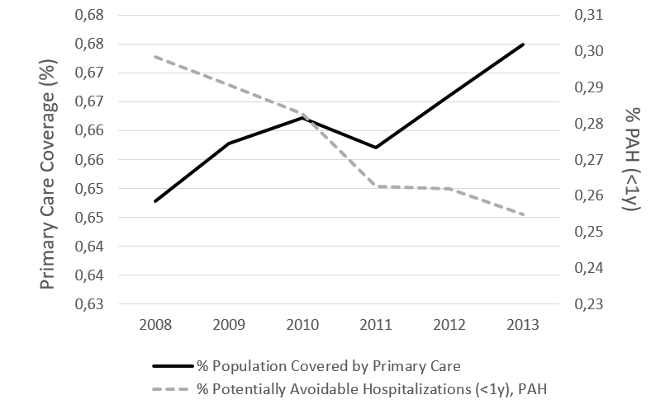
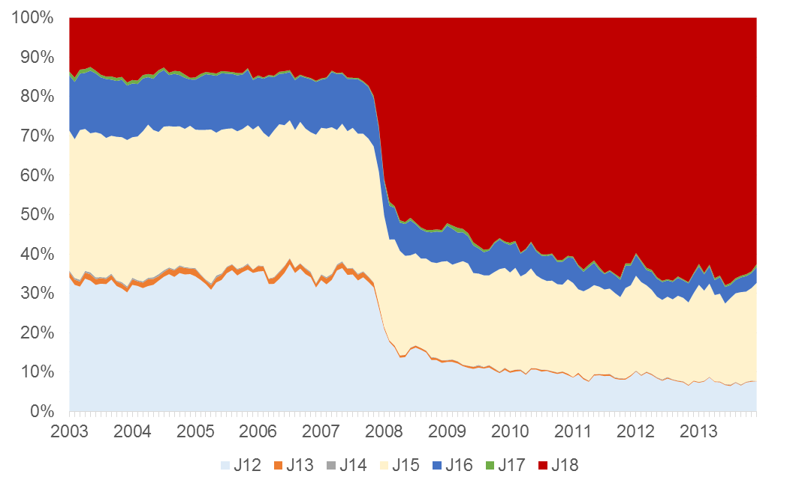
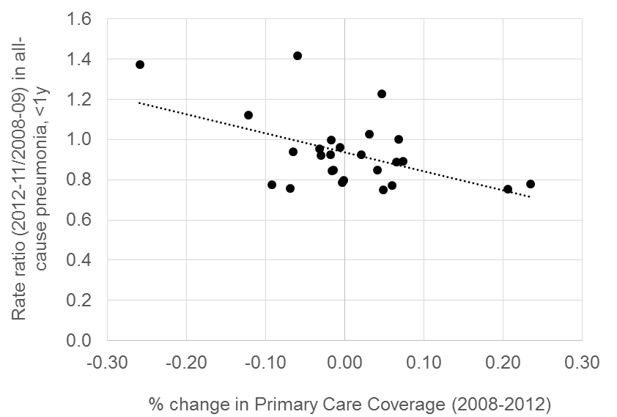
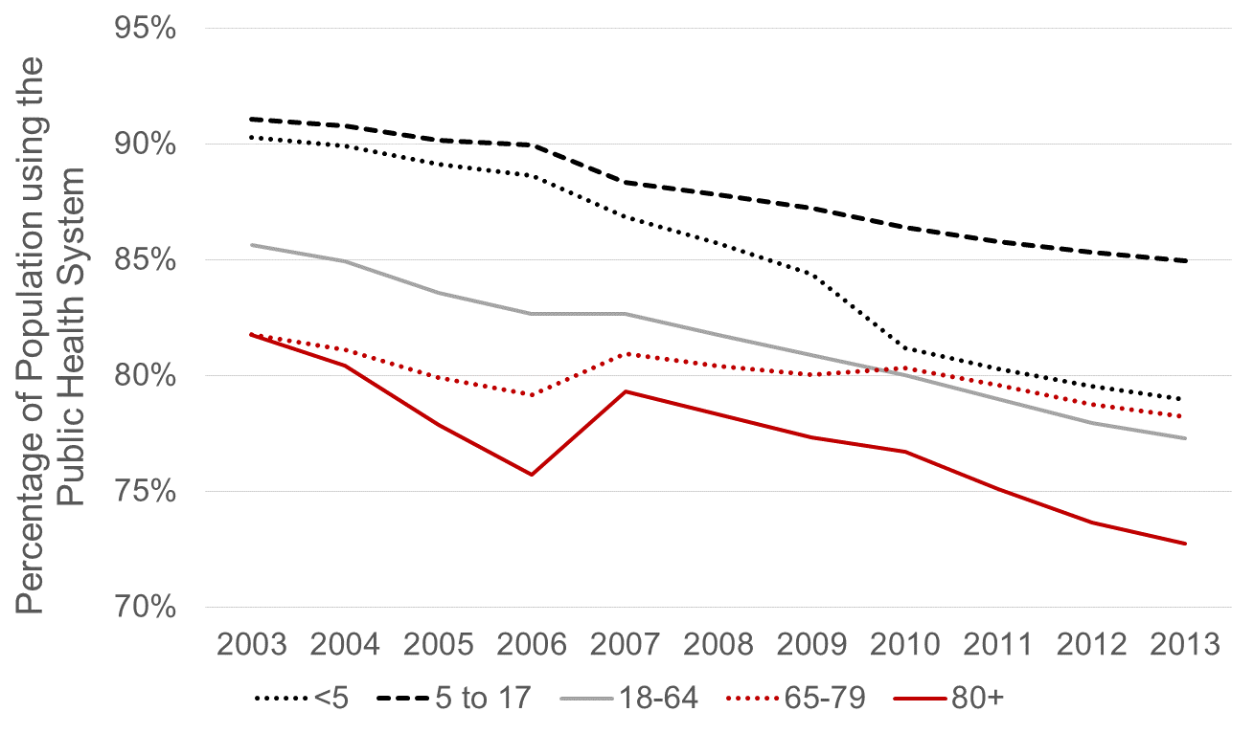
Issues that can affect reported rates from administrative data
Changes in access to primary care
Changes in ICD coding
Pneumonia, unspecified
Potentially-avoidable hospitalizations
Changes in use of public healthcare

Slide 3
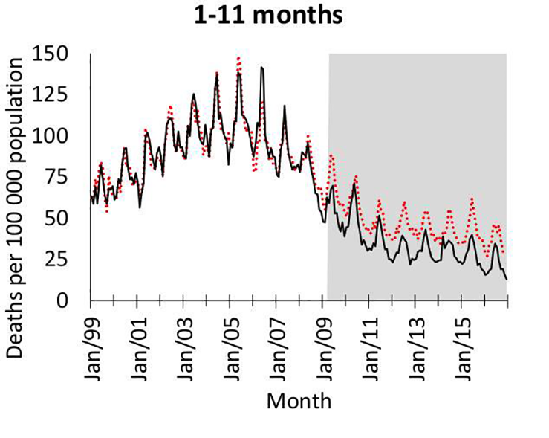
Motivating example: PCVs in S Africa
Pneumonia deaths in S. Africa
HIV/AIDS
HAART
PCVs
Kleynhans, et al PLOS Medicine

Slide 4
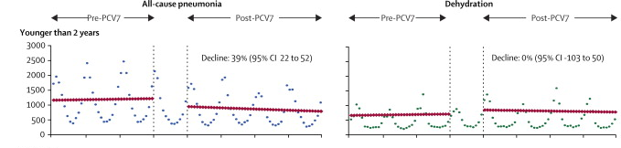
Ways to use control diseases
As a comparison
As an adjustment variable
Grijalva et al, The Lancet 2006

Slide 5
Use control diseases as a comparison
Vaccine
Often used qualitatively
“Pneumonia declines but UTI is stable”
Can be used quantitatively
“Effect of PCV against pneumonia is X%-Y%”
Pneumonia
X% decline
Pre-vaccine
Post-vaccine
Time
Y% decline
Control disease
(e.g.UTI)
Pre-vaccine
Post-vaccine
Time

Slide 6
Use control disease as an adjustment variable
Control disease
Model fit
Pneumonia
Pre-vaccine
Post-vaccine
Time
Step 1: Fit a regression model using data from the pre-vaccine data to establish a
relationship between pneumonia and a control disease
E.g., log(pneumonia)= b0 + b1*log(control disease)

Slide 7
How does it work?
Control disease
Model fit
Pneumonia
Pre-vaccine
Post-vaccine
Time
Step 2: Plug in observed values for control disease from post-vaccine period to get an estimate for what counts of pneumonia would be

Slide 8
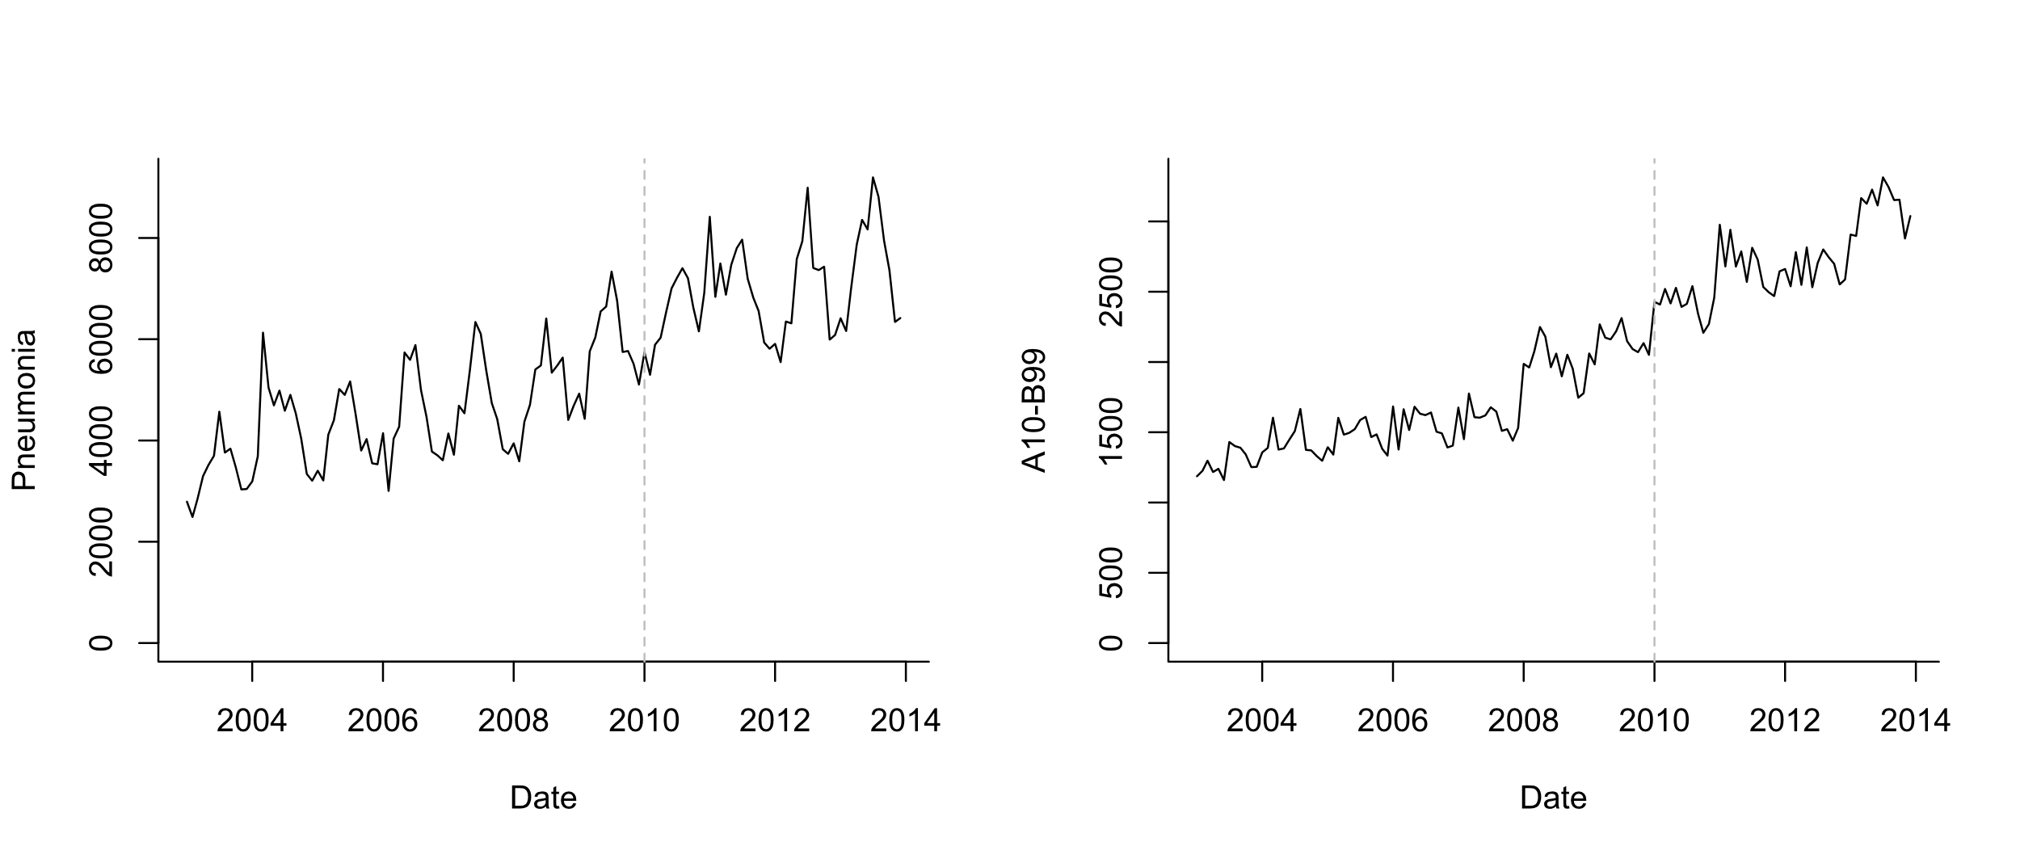
Use control disease as an adjustment variable
Infectious causes (exclude J codes, diarrhea)

Slide 9
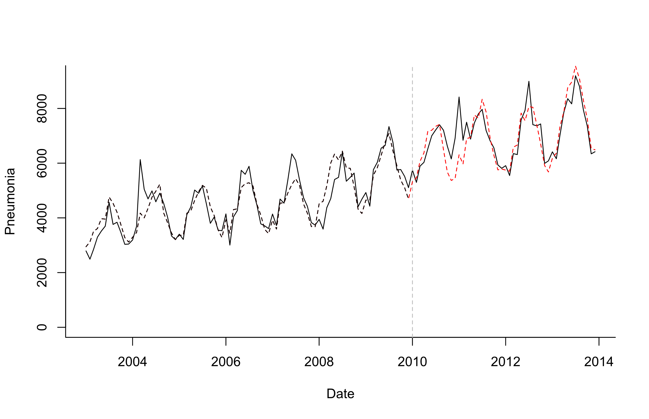
Use control disease as an adjustment variable
Log(Pneumonia)=b0 +b1*sin12 +b2*cos12 +b3*log(A10_B99)
Model Fitting
Extrapolation based on controls

Slide 10
What is a good control for pneumonia?

Slide 12
Principles for selecting candidate controls
Exclude any that could plausibly be influenced by the vaccine (e.g. pneumococcal/streptococcal septicemia)
Relationship should be stable over time except for intervention of interest (e.g. exclude diarrhea following rotavax)
Ideally would share some common causal factors
(Maybe exclude covariates with sparse data (<10 cases/month on average))

Slide 13
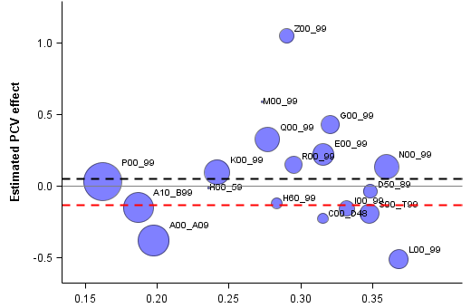
Perils of choosing a single control disease
Diseases of the genitourinary system (UTI)
Composite “PCV effect” on comparators
PCV effect on pneumonia
Diseases of the skin and subcutaneous tissue
More similar to all-cause pneumonia/ACH
**Choosing a single comparator/control is risky—composites are more robust

Slide 14
Letting the data select controls
Synthetic controls/CausalImpact method developed by Google for website analytics (Brodersen)
Select large number of candidate controls a priori
Use “automatic” Bayesian variable selection to give more or less weight to specific control diseases in the final model
Log(Pneumonia)=b0 +b1*sin12 +b2*cos12 +b3*control1+ b4*control2+ b5*control3…

Slide 15
What does synthetic controls do?
Outcome
(all-cause pneumonia hospitalizations)
ICD-10: J12-18
Control diseases
Various ICD-10 codes
34 diseases
(Children <12 mo in Brazil is used as an example)

Slide 16
What does synthetic controls do?
Fit regression model to pre-vaccine data only
Test different control variables alone or in combination
In forward or backward variable selection, you would drop less important variables
With this approach (Bayesian variable selection), you never drop any variables, you just give them more weight
Gives you a regression model with a set of controls that do the best job at explaining trends in pneumonia pre-PCV
Extrapolate to post-PCV period based on changes in the control variables

Slide 17
Components of the synthetic control model
Log(pneumonia cases_t)=b0+ sum(incl_i*b_i*log(control_i_t)) + sum(c_k*season_k)
Binary inclusion indicator for control series i
Time series for candidate control disease i
Monthly dummies to control for
Seasonality
“Spike and slab” prior for incl_i*b_i

Slide 18
Top control: B50-B89 (Protozoal diseases; Helminthiases; other infestations (could be linked to HIV)
Kleynhans, et al PLOS Medicine

Slide 19
Sensitivity analyses that are good to run
If have 6 years of pre-vaccine data, fit model to first 5 years, estimate “rate ratio” for 5th year
Should be ~1
Try dropping top 1,2,3 control variables; see if estimates change

Slide 20
Synthetic Controls: Pros and Cons
Provides flexible and robust approach to estimate vaccine impact
2 strong assumptions
None of the controls are influenced by the vaccine
The relationship between pneumonia and the controls does not change over time
Modifications needed for optimal use in small populations
Doesn’t guarantee you will detect/adjust for all confounding, but it increases the chances of success

Slide 21
What if we can’t identify appropriate controls because the data are too noisy?

Slide 22
Issues with Sparse Data
National:
PCV
Hard to assess correlations between the outcome and control diseases when data are noisy
Outcome
Controls
No. of cases (standardized, log)
SC model fails to select appropriate control disease(s) and generates unreliable prediction
What if we only observe 0.25% of cases? (ie small state in Brazil)
Outcome
Controls
No. of cases (standardized, log)
Notes:
A41: Other sepsis
I00_99: Diseases of the circulatory system

Slide 23
Solution: smooth the control diseases and use the smoothed summary in the model (STL+PCA)

Slide 24
Some guidelines
Using a control disease is critical
Avoid simple time trend adjustment
At a minimum, adjust for all-cause mortality/hospitalization
If at least 1 control disease identified, use the results from synthetic controls
If no control diseases identified, it is often because the data are too sparse: use sparse data approach (STL+PCA)

Slide 25
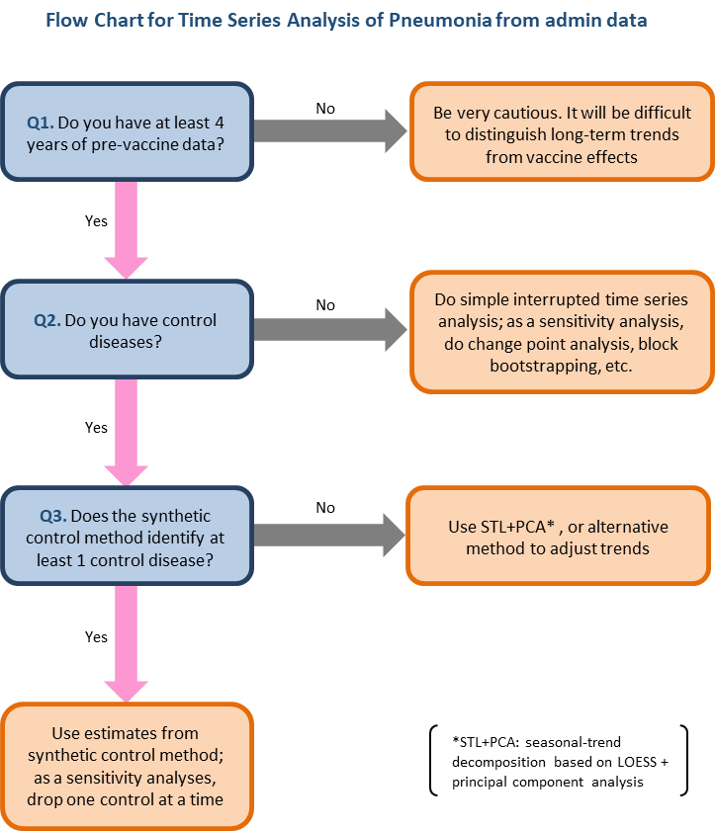
Kayoko Shioda, DVM, PhD MPH

Slide 26
Resources for using synthetic controls with administrative data
R package:
https://github.com/weinbergerlab/InterventionEvaluatR
Interface: dev.interventionevaluatr.com
Tutorial from Google
https://google.github.io/CausalImpact/CausalImpact.html
Original Google Paper
https://static.googleusercontent.com/media/research.google.com/en//pubs/archive/41854.pdf

